Slide 1
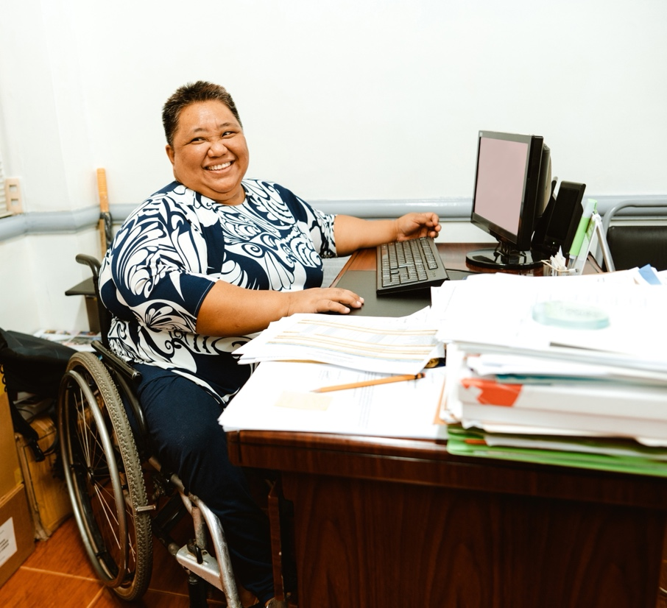
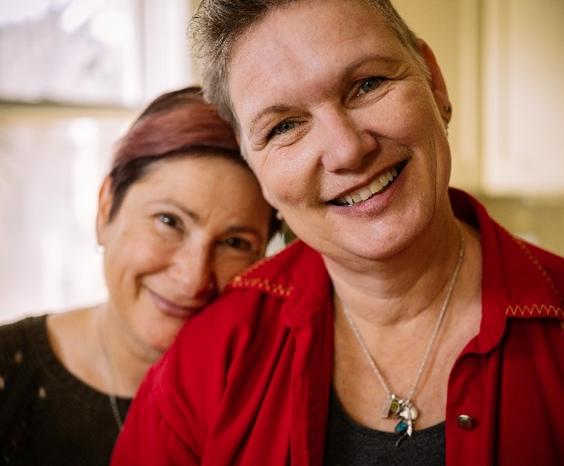
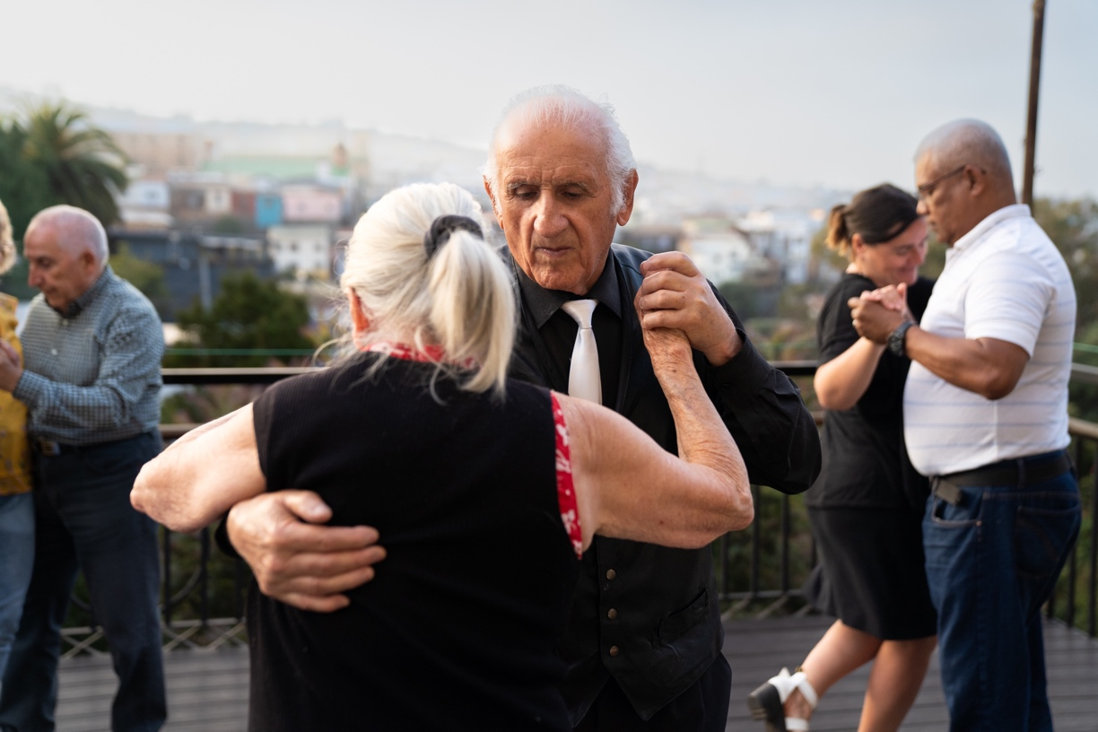
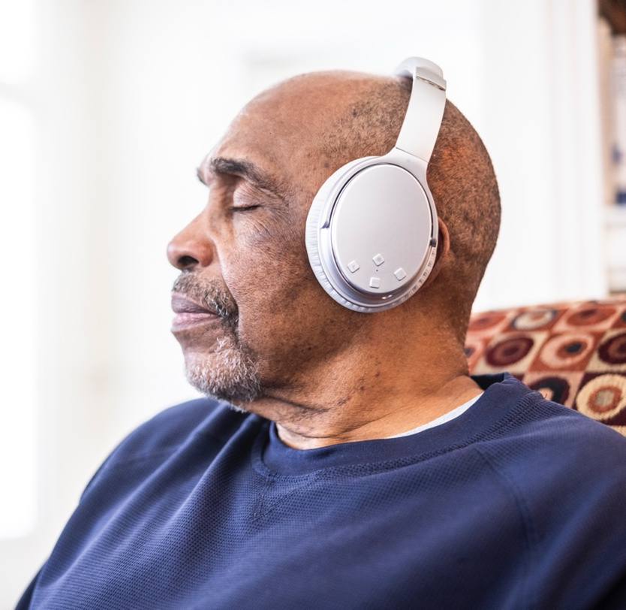
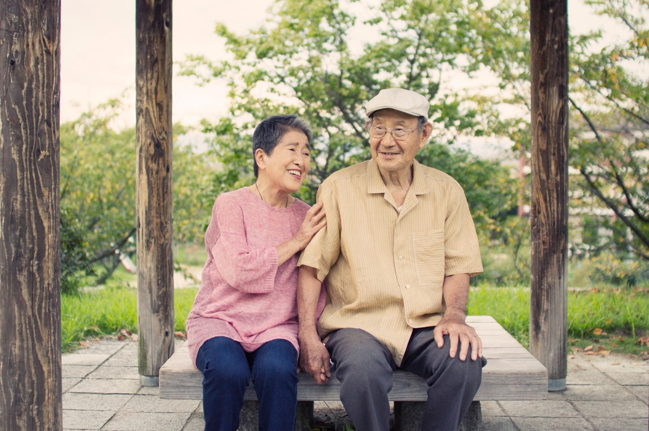
LIVED EXPERIENCE
Presented by AARP RESEARCH
The hearts and minds of adults age 50 and older along the multi-dimensional journey in aging
AARP.ORG/RESEARCH | © 2024 AARP ALL RIGHTS RESERVED | AARP RESEARCH
1
Notes:
I call this presentation Lived Experience because it reflects an idea that age can be seen as an accumulation of life experiences that we learn from and build on; and while adults ages 50 and older are incredibly diverse and have wide-ranging experiences, this journey unites.
A little about AARP, we are a non-profit, non-partisan organization whose social mission is to empower people to choose how they live as they age.
Within AARP Research, we conduct thousands of interviews every year for insights to inform the public, elected officials and our own organization on the wants and needs and experiences of adults 50 and older.
You may also hear me use the term older adults today. We’ve found that it’s best practice to be as specific as possible, for example, adults 50 and older, but in the absence of specifics, older adults is generally the preferred term. You won’t hear me use the term seniors today. While that term is used in advocacy contexts generally referring to adults 65 and older, it is generally not the preferred term among older adults themselves.
I focus on audience research for AARP, which is about knowing people across population segments as they age. So, while other researchers at AARP are focused on issues areas, our team is focused on a holistic, person-centric view.

Slide 2
“Age is essentially a culmination of experiences gathered along the way toward learning about who we really are…At my age I feel I am on my way to uncovering things about myself that I had forgotten, while I worried about what the world thought of me.” -Man who is passionate about the arts and his creative side, works in galleries, loves cats, in his 50s
2
Notes:
To set the stage, I’d like to read this quote from one of our research participants. He says, “Age is essentially a culmination of experiences gathered along the way toward learning about who we really are…At my age I feel I am on my way to uncovering things about myself that I had forgotten, while I worried about what the world thought of me.”
I love this quote. I love it because it views age as progression.
So, today, I am going to challenge what you know about adults 50 and older and their experience along the aging journey.
We will talk about age as an accumulation of life experiences that we learn from to look ahead.
We will talk about how people are living longer and opportunities associated with longevity.
We will talk about how aging is multi-dimensional and involves our relationships, our health, our money and our purpose.
We’re going to talk about how it is complex and involves opportunities and challenges and growth and changes.

Slide 3
Presentation Goals
Take away at least ONE insight to:
Resonate with your audience members age 50 and older
✓
Educate or engage your audience about the aging experience
✓
Notes:
As we talk about the experiences of adults 50-plus along the aging journey, I’d like you to write down at least one insight you learn to either
resonate with your audience members age 50 and older or
(2) to educate or engage your audience on the aging experience.

Slide 4
There are 122 MILLION adults age 50 and older in the United States, and this population segment is growing.
U.S. Census Bureau, November 2023.
Notes:
First, some grounding statistics. There are 122 million adults 50 and older in the United States (that’s almost half of the adult population), and the Census projects this segment will grow by 7% by 2030.
This is driven by the 65 and older population. As we can see in this chart, as indicated by the orange line which shows the projected population size over the next 10 years, the 65 and older population will outnumber those under 18 in 2029. So, it is critical to really get closer to the hearts and minds of adults over 50 to understand their wants and needs.

Slide 5
Adults age 50 and older are incredibly diverse.
34% 50-59
33% 60-69
32% 70 and older
11% Black/African American
2% American Indian/Alaskan Native
6% Asian American
12% Hispanic
78% White
44% working 69% 50-64 | 19% 65+
60% married, 18% divorced/separated, 10% never married, 12% widowed
79% parents
7% parents of children < 18 (including 18% 50-59)
62% grandparents
20% caregivers
Age, race/ethnicity, marital status: American Community Survey (ACS PUMS) 2022; Employment status: 2023 Current Population Survey, Bureau of Labor Statistics (BLS);​
Parents: MRI-Simmons USA Fall 2023 Report © 2023, MRI-Simmons; Grandparents: Well-being and Social Connectedness Omni,” (August 2023).
Notes:
When we talk about adults 50 and older we are talking about a very large age span.
About a third of people 50 and older are in their 50s, a third are in their 60s, and a third are 70 and older.
They are incredibly diverse in their life stages, roles, responsibilities, priorities, challenges, goals, and aspirations across the age span but also within.
So, I can’t possibly talk about it all, but I do identify areas that you may be less familiar with and important themes that highlight this diversity amidst the collective experience of continuously accumulating lived experience as we age.
Caregiver defined as providing unpaid care to an adult loved one with health or functional needs.

Slide 6
Concerns generally decrease with age, except when it comes to relationships.
AARP's Second Half of Life Study, 2022.
Notes:
Based on our experience conducting many studies on adults 50 and older, when you ask them some variation of what’s in their heart or on their mind, you most often get some combination of response related to their relationships, their health, their finances, and their purpose. And these dimensions are very interconnected.
As we can see here, we asked adults across age groups how concerned they were about each of these areas with age across the horizontal axis, starting at age 18 through ages 80-plus – and interestingly concern generally declines with age – except for relationships – more on that later. But over the course of this discussion, we will follow these general pillars.

Slide 7
“My huge, wonderful family. Especially my #1 Daughter and # 1 Granddaughter. I am the great great grandfather.” -Father and grandfather who is in his 70s, on what contributes to his well-being
Notes:
I want to start by talking about Connections. I’m doing this intentionally. Oftentimes in the context of discussions on older adults, we headline conversations about well-being from the standpoint of physical health.
And, of course that’s important, but I think then we lose the multi-dimensionality of people’s lives and their experiences with aging. I want to read a quote from one of our research participants, when we asked “what contributes to your overall well-being as you get older,” he says, “My huge, wonderful family. Especially my #1 Daughter and # 1 Granddaughter. I am the great great grandfather.”
When we listen to adults 50 and older talk about the contributions of family to their well-being, we hear stories about love and support, family togetherness and quality time, and also pride and enjoyment in witnessing family members grow.

Slide 8
With age, adults increasingly attribute their sense of joy and purpose to family and friends.
Percent who say family and friends contribute a great deal to a sense of purpose and a sense of joy
AARP's Second Half of Life Study, 2022.
Notes:
The chart on the left shows the percent who say family contributes a great deal to purpose and joy (purpose is in orange, joy in blue) with increasing age on the horizontal axis from ages 18 to 80 and older and the one on the right shows the percent who say friends contribute to purpose and joy. And so we see with age, adults increasingly attribute their joy and purpose to family and friends. It’s always important, but does tend to come into greater focus with age.
These charts also show that overall, adults of all ages are particularly likely to think of family when they think about purpose and joy, but I also want to highlight friendships, because they are critical.
Friends are the top source of emotional support for divorced, separated, never married and widowed adults 50-plus, along with children. So, friends are such a key component of resilience from social isolation and loneliness across life stages.

Slide 9
Men tend to rely on spouses, women rely on broader networks.
AARP Research, “Well-being and Social Connectedness Omni,” (August 2023).
Notes:
There are also some interesting gender differences. Men cite spouses as who they rely on most for purpose and joy, women most often mention children. Women are also more likely to say friends and grandchildren contribute greatly to joy and purpose.
Underlying this, women are more likely to have frequent interactions with a wider variety of people, whereas men (who are more likely to be married) tend to rely more heavily on their spouses for social contact.
This is reflected in this chart which shows the percent of men, in blue, and women, in red, who interact with each of the relationships listed more than once a week, and we see women are more likely to have interactions in every relationship category expect for spouses and partners.
Studies show in widowhood, women tend to fare better mentally in part because they have a more robust social network.

Slide 10
Many LGBTQ+ adults age 45 and older have spouses, partners, children and grandchildren, however 8 in 10 are at least somewhat concerned about having adequate social supports as they age.
Dignity 2022: The Experience of LGBTQ Older Adults. AARP Research.
Notes:
I also want to highlight AARP’s Dignity study of LGBTQ+ adults 45 and older. The green bar here shows the percent of LGBTQ+ respondents who have children, the blue – the percent who have grandchildren, the red – the percent who are married or in a civil union or domestic partnership, and the orange, those who are otherwise living with a partner. So, we see many LGBTQ+ survey respondents are in a partnership or have children and grandchildren, especially bisexual and transgender and nonbinary respondents.
However, gay men are particularly less likely to be married, have children or grandchildren and more likely to live alone, which can be a risk factor for social isolation. So, we do see having adequate social support as they age is a concern for many LGBTQ+ older adults. This also highlights how critical friends as chosen family are.

Slide 11
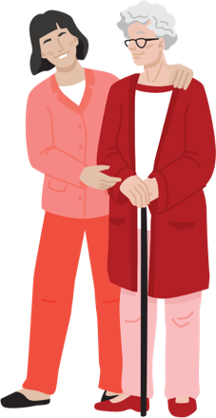
Black/African American, Hispanic and Asian Americans are two times more likely than White adults to live in multi-generational households.
Driven by…
✓
Love, connection
“What brings me joy is to being able to be a caregiver to my aging aunt that has Alzheimer's and Dementia. Being able to stay strong and positive the key to my success.”
-woman who lives with fiancé and grandchildren, caregiver, loves beaches, parks, in her 60s
✓
Obligation, duty
✓
Interdependence (caregiving, living with adult children, grandchildren)
✓
Finances
Pew Research Center analysis of 2021 Current Population Survey Annual Social and Economic Supplement (IPUMS); Caregiving in the United States 2020.
Notes:
Our social connections survey also showed Black/African American and Hispanic adults 50-plus tend to interact more frequently than White adults with a wider family network, including children, siblings, grandchildren as well as extended family members.
Related to this, is the fact that Black/African American, Hispanic and Asian Americans are about twice as likely as White Americans to live in multi-generational households.
The chart on the left shows the percent living in multi-generational households by race or ethnicity, and uses Pew Research’s definition, which includes at least two generations of adults generally 25 and older or grandparents and grandchildren younger than 25.
Multi-generational living is driven by a variety of reasons, including internal motivations like love and connection and obligation and duty – which are particularly strong motivators for Hispanic and Asian American adults.
Relatedly, interdependence is both a driver and an outcome of multi-generational living.
One example that occurs both inside and outside of multi-generational living situations is caregiving, by that I mean providing unpaid care to an adult loved one with health or functional needs. About 1 in 5 adults 50 and older are caregivers, so this is a very significant part of life for many people over 50 and is amplified among those who live with their care recipient, as they spend more time caregiving. Other examples of interdependence include more young adults living in their parent’s homes than they have in the past, and grandparents providing care to their grandchildren.
Note: multi-generational households include at least two generations of adults mainly ages 25 and older or grandparents and grandchildren younger than age 25. White, Black/African American and Asian Americans include those who report being only one race and are non-Hispanic. Asian Americans include Pacific Islanders. Hispanic is of any race. Source: Pew Research Center analysis of 2021 Current Population Survey Annual Social and Economic Supplement (IPUMS); AARP and National Alliance for Caregiving. Caregiving in the United States 2020. Washington, DC: AARP. Race groups are non-Hispanic. May 2020. https://doi.org/10.26419/ppi.00103.001.
Quote from qualitative study of Hispanic adults 50-plus.

Slide 12
Grandchildren are a pride and joy; grandparents are a vital support.
Of grandparents say they rely most on their grandchildren for joy.
Of grandparents play a daycare or babysitter role, especially true for Asian American grandparents at 51%.
Travelled with grandchildren in year prior to survey. A third have taken their grandchildren on a skip-gen trip before.
Joy: AARP Research, “Well-being and Social Connectedness Omni,” (August 2023); Remaining figures: 2018 Grandparents Today National Survey, AARP Research.
Notes:
I’d also like to speak more broadly about grandchildren. When grandparents age 50-plus are asked who they rely on for joy in their life, 53% say they rely most on their grandchildren.
And, many grandparents play vital support roles with 38% playing a daycare or babysitting role in their grandchildren’s lives. This is especially true for Asian American grandparents.
Four-in-ten grandparents say they have travelled with grandchildren in the past year (at the time the survey was administered). A third have taken their grandchildren on skip gen trips before, which are trips including grandparent and grandchild (but not the grandchild’s parent).

Slide 13
Adults age 50 and older are more likely to worry about the well-being of their loved ones than their personal well-being.
They are more likely to worry about their children than any other relationship – and this holds true throughout the life course.
AARP Research, “Well-being and Social Connectedness Omni,” (August 2023).
Notes:
To underscore the importance of family and friends, we asked a survey question that finds adults 50 and older are more likely to worry about the well-being of their loved ones than their own personal well-being.
And when we ask them who they worry about most, they answer their children.
I find this data point so compelling because across ages this remains true, as shown in this chart here.
So across the 50-plus age span, we see parents who still have children at home, or children getting jobs or going to college, or starting to live on their own. We hear worries about prospects for children. We also hear concerns about physical safety, and this is something that comes up especially for mothers of young Black men. We see worries as children may start to have children of their own, and experience family changes and financial well-being challenges. As we move into older age our children become more likely to have health issues of their own. Sometimes we find worries are even more abstract, like worry about the world that their children will be living in.
We also see for African American families a strong value and sense of duty and obligation for the next generation, including taking care of, mentoring, sheparding, and building a strong community for the generation that follows.

Slide 14
As we grow older, we experience an increasing number of major life changes, including retirement, children leaving home, the loss of loved ones, physical and health challenges…The truth is that we are stronger and more resilient than we may realize. -Woman who is a state government employee and mother of two adult sons, in her 50s
Notes:
One area we know connections are vital for is mental health. First, I’ll discuss resilience. I’ll start by reading this quote from one of our research participants, she says: As we grow older, we experience an increasing number of major life changes, including retirement, children leaving home, the loss of loved ones, physical and health challenges…The truth is that we are stronger and more resilient than we may realize.

Slide 15
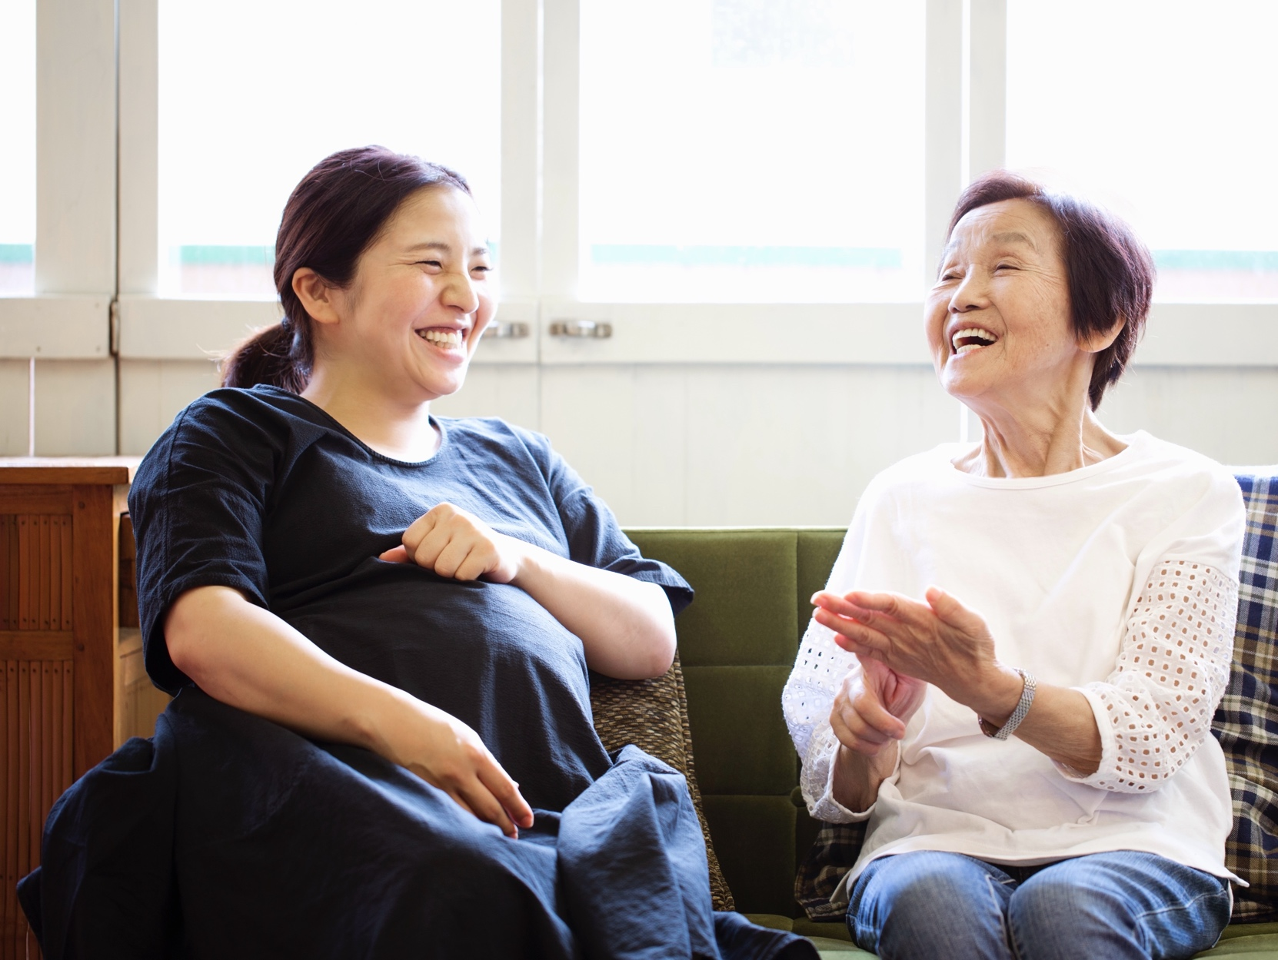
Six in 10 adults age 50 and older rate their resiliency highly.
They agree they can bounce back after hard times and recover from stressful events.
Healthy Living: A look at how older adults are managing their emotional and mental well-being. An AARP Health Living Survey of adults ages 50 and older, 2022.
Notes:
I read this quote because with age, adults 50-plus are increasingly likely to rate their level of resilience highly. About 6 in 10 adults 50-plus agree they can bounce back quickly, and emerge through difficult times.

Slide 16
Happiness grows with age.
Increased ability to…
✓
To cope
To cope
✓
See the big picture
✓
Focus on positive events
✓
Release from unmet expectations
AARP's Second Half of Life Study, 2022.
Notes:
Relatedly, with age, happiness grows. The chart on the right shows in blue the percent who say they are very happy by increasing age. This really counters the societal narrative that older age is about decline and loss.
There are a few underlying mechanisms that may be at play here. (1) Research has shown an increased ability to cope with an accumulation of life experiences behind us, (2) it has also shown that our brains are better able to see the bigger picture https://www.psychologytoday.com/us/blog/achievements-the-aging-mind/202001/seeing-the-big-picture-we-age (3) studies also show with age an increased ability to focus on positive events, called the positive effect, and (4) with age we tend to release ourselves from unmet expectations.
Of course, I do not mean to gloss over individual experiences and struggles, mental health challenges exist throughout the life course. Moreover, if we internalize our resilience, we can be less likely to seek out help in the face of challenges, so that is very important to understand. But I did want to highlight this macro trend. Gallup came out with their World Happiness report recently and it showed older adults fared a lot better than younger adults in the United States, with younger adults really struggling amidst a mental health crisis, and one of the reasons for these different outcomes may be this resiliency that is built from lived experience.
Why you should thank your aging brain - Harvard Health

Slide 17
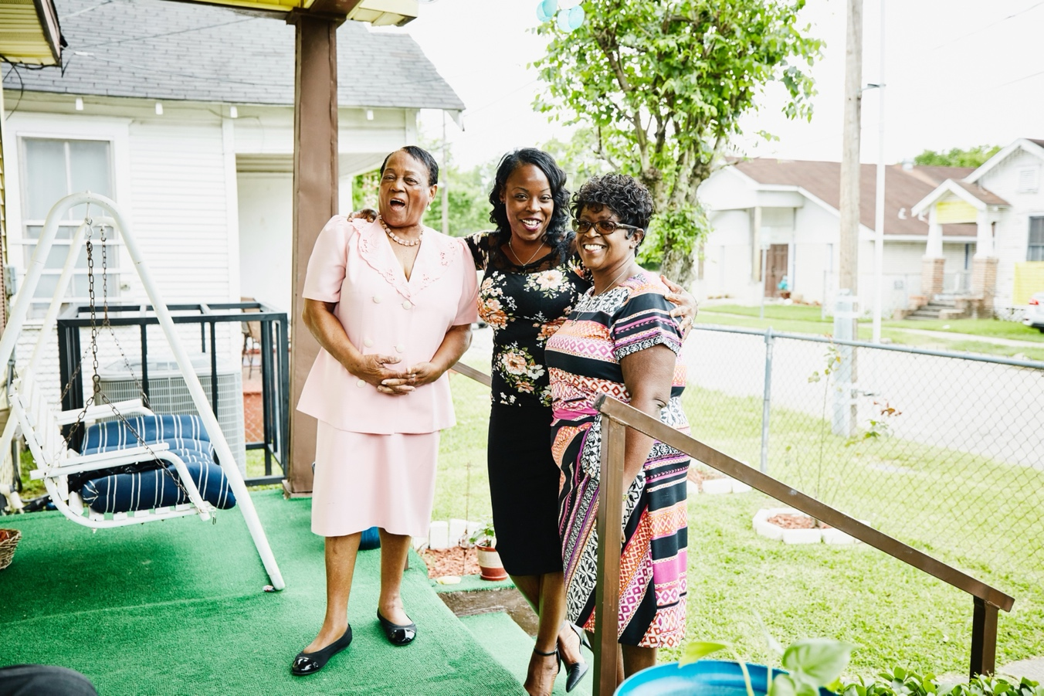
While religious affiliation is declining in the United States, religion and spirituality remains important for most adults age 50-plus.
“My faith and my family.”
-woman who works in apparel/fashion industry, in her 50s in response to what contributes to well-being
AARP Research analysis of the National Poll on Healthy Aging (NPHA), 2022.
Notes:
Expanding on this idea of coping, one of the areas that is palpable in our research, is the importance of faith and spirituality. While religious affiliation is declining in the United States with each generation, it is still vastly important for older adults. And, we find this to be especially true for Black/African American adults age 50-plus. In the chart on the bottom line here, we see that 94% of Black and African American adults over 50 say spiritual beliefs are important to them, compared to 80% of the total population over 50.

Slide 18
“Staying as healthy as possible means more quality time with family” -Father, grandfather and pet parent, proud of 25-year career, in his 60s
Notes:
Moving on to the dimension of physical health, which is so intertwined with connections and mental health…I want to read this quote from a research participant: “Staying as healthy as possible means more quality time with family.”
What this illustrates is that for adults 50 and older, health means potential. It is a facilitator, enabling them to do what makes them happy and be with and support the ones they love.

Slide 19
Even as serious health conditions increase with age, self-perception of health somewhat improves.
AARP's Second Half of Life Study, 2022.
Notes:
This chart here is from AARP’s Second Half of Life study. The horizontal axis is age starting at age 18 through ages 80-plus and the orange line is the % saying their health is excellent or very good, and the blue line is the percent with at least once serious condition. So, even as serious health conditions increase with age, self-ratings of health somewhat increase. What this could demonstrate is that health is more of a dynamic concept than a standard, and an individual can be accepting of having a health condition while maintaining many aspects of their health.
It also may demonstrate that self-perceptions of health may relate to expectations. I share this chart because I think when we only focus on health problems, we lose sight of this picture.

Slide 20
Chronic disease incidence increases with age.
AARP's Second Half of Life Study, 2022.
Notes:
At the same time, I also need to talk about chronic conditions because it is top of mind for adults 50 and older and important in relation to accessibility and inclusion. The proportion of adults 50 and older with a chronic or serious condition increases from about two thirds in one's 50s, to three-quarters in one’s 60s to four in five for those 70 and older.

Slide 21
For Black/African American, Hispanic and indigenous populations, the reality of dealing with chronic disease begins earlier.
Behavioral Risk Factor Surveillance System (BRFSS), BRFSS Web Enabled Analysis Tool: Cross Tabulation.
Notes:
But, for Black/African American, Hispanic, and indigenous populations, the reality of dealing with chronic disease begins earlier. The orange chart here documents the approximate age along the horizontal axis at which half of adults in each race or ethnicity group will have been diagnosed with hypertension; the blue chart shows the age in which one in five adults will have been told they have diabetes. So, half of Black/African American and American Indian/Alaskan Native adults have been told they have high blood pressure by the time they are in their 50s, about 10 years before the total population on average. One in five American Indian/Alaskan Native, Black/African American and Hispanic adults have been told they have diabetes in their 50s, while this incidence level is not reached until one’s 60s for the total population.

Slide 22
While the US population is living longer, Black/African American and American Indian/Alaskan Native people have significantly shorter life expectancies than average.
Arias E, Tejada-Vera B, Kochanek KD, Ahmad FB. Provisional life expectancy estimates for 2021. Vital Statistics Rapid Release; no 23. Hyattsville, MD: National Center for Health Statistics. August 2022. DOI: https://dx.doi.org/ 10.15620/cdc:118999. Accessed via Kaiser Family Foundation.
Notes:
So while the US population is living longer than before, the life expectancy for Black and African American people is 5 years shorter than the total US population, and is 11 years shorter for American Indian/Alaskan Native people. There has been a lot of discussion about the impact of the social determinants of health on these outcomes, but what is less discussed is the theory of Weathering.
NOTE: Estimates based on provisional data for 2021. Persons of Hispanic origin may be of any race but are categorized as Hispanic for this analysis; other groups are non-Hispanic.

Slide 23
Weathering
Weathering
Accelerated aging caused by social stressors
Accelerated aging caused by social stressors
✓
Accumulation of constant stress, especially pronounced for those facing inequity
Body’s ability to recover is blunted by repeated exposure to stressors, regulation of body’s stress hormone is disrupted leading to chronic disease
✓
“Stress Is Weathering Our Bodies from the inside Out.” Washington Post. October 17, 2023.
23
Notes:
Weathering is the process, first suggested by health equity researcher, Arline Geronimus, of accelerated aging caused by social stressors. Weathering is a universal experience, but it is felt more strongly among marginalized populations. It describes that in life we experience an accumulation of constant stress from immediate and chronic threats (or the anticipation of threats) which is especially true for those facing inequity.
The body’s ability to recover from such stressful events is blunted by repeated exposure to psychosocial and environmental stressors that people not only experience but withstand and struggle against, such as racial discrimination.
This means that regulation of the body’s stress hormone is disrupted, which can lead to accelerated aging and chronic disease.
I was reading an article in the online publication, The Conversation, the other day, and it posed the question: Did racism kill Jackie Robinson? Here is someone who was a superior athlete. Yet, he was diagnosed with diabetes at 37, suffered two mild strokes, high blood pressure and three heart attacks, one of which was fatal at 53 years old. This is also someone who endured racism throughout his life course, starting in childhood and throughout his storied professional career. I share this story as one illustrative example of how this theory of weathering may have manifested: https://theconversation.com/did-racism-kill-jackie-robinson-156924
Johnson, Akilah, and Charlotte Gomez. 2023.

Slide 24
The proportion who feel they will likely get dementia is greater than the proportion who will.
48%
of adults age 40 and older think it is likely they will get dementia.
”AARP Survey on the Perceptions Related to a Dementia Diagnosis: Adults Age 40+,“ (June 2021); “One in 10 Older Americans Has Dementia,” Columbia University Irving Medical Center, (October 20, 2022).
Notes:
I also want to talk about brain health because maintaining brain health is consistently the top health concern we hear from our constituency. Likely contributing to this fear is that adults are generally more likely to feel they will get dementia than will acquire it. (Dementia is a general term for loss of mental abilities that are severe enough to interfere with daily life). About half (48%) of adults age 40 and older think it is likely they will get dementia. Researchers from Columbia University estimate that 10% of U.S. adults age 65 and older have dementia.
I must also note dementia is not a normal part of aging. As we can see with the chart, risk of dementia increases with age from an estimated 3% between ages 65-69 to 35% of adults at age 90-plus. When we think about population aging, as our society gets older, the impact of dementia will be heightened – both for the individuals and their families and caregivers. So it is so important to have a multi-faceted discussion about risk reduction through lifestyle changes (which there currently is a lack of knowledge about), treatments, as well as well-being while living with dementia.
***********************************************************************************************
https://www.alz.org/alzheimers-dementia/difference-between-dementia-and-alzheimer-s#:~:text=Alzheimer's%20disease%20is%20the%20most,affect%20thinking%2C%20behavior%20and%20feelings.
Dementia is a general term for a decline in mental ability severe enough to interfere with daily life, while Alzheimer's is a specific disease. Alzheimer’s is the most common cause of dementia.
Learning about the two terms and the difference between them is important and can empower individuals living with Alzheimer’s or another dementia, their families and their caregivers with necessary knowledge.
Dementia overview
Dementia describes a group of symptoms associated with a decline in memory, reasoning or other thinking skills. Many different types of dementia exist, and many conditions cause it. Mixed dementia is a condition in which brain changes of more than one type of dementia occur simultaneously. Alzheimer's disease is the most common cause of dementia, accounting for 60-80% of dementia cases.

Slide 25
“Being financially secure enough to retire and live a comfortable life.” -Woman who is self-employed, in her 50s
Notes:
Moving on, I’d like to discuss financial well-being, as financial concerns are top of mind for adults age 50 and older. I’ll start by reading this quote; in response to what are your goals, one of our research participants says, “being financially secure enough to retire and live a comfortable life.” This quote is indicative of what we hear about the relationship with finances to well-being – it’s about financial security, stability and comfort.

Slide 26
Ratings of financial health are split, reflecting a range of financial experiences.
It is estimated that 48% of adults age 65-plus living alone, and
21% of couples lack the financial resources to pay for basic needs and age in place in their homes.
AARP Research, “Financial Worries: Views of Adults Ages 50+,” March 2022; “Elder Economic Security Standard™ Index (Elder Index),” (February 14, 2023).
Notes:
Adults age 50-plus are split in terms of how they rate their financial well-being, with around a third rating it very good or better, and a little over a third rating it fair or poor. We know this reflects a wide range of financial experiences and personal situations. For example, The Elder Index, developed by the University of Massachusetts Boston, measures the cost of living for adults age 65-plus, and estimates that nationally nearly half of adults age 65 and older living alone and one in five older couples will lack the financial resources to pay for basic needs as they age.

Slide 27
Present and future financial concerns weigh on the minds of adults age 50 and older.
Financial concerns are especially pronounced among people in their 50s, followed by those in their 60s.
“AARP Financial Security Trends Survey,” AARP Research, (July 2023).
Notes:
We also see that worries about finances today and for the future are especially pronounced among those who are not yet retired. Looking at the second item in this chart, three quarters of adults in their 50s worry about having enough money to be financially secure throughout retirement years, compared to 61% of those in their 60s and 45% of those 70-plus. We talked earlier about older adults potentially being less likely to worry in general with accumulated life experience. There also might be more feelings of uncertainty among those in their 50s and 60s. Many might also be in the life stage where they are juggling a lot of financial responsibilities. In one of our studies of adults ages 40-64, we found a third of those with living parents provided financial support to them, and 51% of those with adult children provided financial support to them.

Slide 28
One in five non-retired adults age 50-plus have no retirement savings.
“AARP Financial Security Trends Survey,” AARP Research, (July 2023).
Notes:
This chart is very striking, because it shows in the red, one in five non-retired adults 50-plus report having no retirement savings. 1 In 5. A quarter say they have less than $50K. So, this really speaks to the financial challenges that people are facing.

Slide 29
Adults are working longer than they have in the past driven by changes in society, culture, and health and longevity.
Reasons include…
✓
Increases in Social Security full retirement age
✓
Defined benefit → defined contribution plans
✓
More highly educated workforce
✓
Increased health and longevity
✓
Purpose, engagement, identity
Pew Research Center analysis of Current Population Survey Annual Social and Economic Supplement (IPUMS). Data accessed at Washington Post.
Notes:
As such, I want to talk about work and retirement. The vast majority, 71%, of adults ages 50-64 are in the labor force. And, on average, older adults are working longer than they have in the past. The chart on the right shows the percent of adults age 65 and over who are working has increased from 12% in 1980 to 19% in 2023. Reasons for working longer include changes to Social Security and employer-based retirement plans, the changing nature of jobs, a more highly educated workforce, and a healthier workforce with longer life expectancies. Changing societal norms may also influence attitudes about work, with research showing that both financial and non-financial reasons inform the decision to continue working, such as work providing engagement and a sense of purpose. For many workers across the 50-plus age span, career is tied to identity.
We also know that 55% of adults age 50-plus who are not yet retired expect to either work for pay in retirement (32%) or never retire (23%). This could signal people continuing to work for both financial and non-financial reasons, but also decades of research has shown that actual retirement age is always below expected retirement age, as many people retire earlier than expected; most frequently citing health reasons. Moreover, workers with lower income are especially likely to retire early due to health, so opportunities to work longer are not equally available to people with compounding financial and health issues.

Slide 30
“Spending more time with my wife. Enjoying life outdoors. Participating in community events. Visiting with our daughter.” -Father and husband, in his 60s in response to what he looks forward to
Notes:
We talk about career as being one source of purpose, and of course family and friends becoming increasingly central with age, but I want to talk about purpose more broadly. In response to what he looks forward to in life, one of our research participants says “Spending more time with my wife. Enjoying life outdoors. Participating in community events. Visiting with our daughter.”

Slide 31
Purpose is strongly associated with well-being.
McKinsey Global Healthy Aging Survey, 2023.
Notes:
We know that purpose is highly associated with well-being. In fact, in a global McKinsey study of adults age 55 and older, purpose was a top factor associated with perceived health. And the study finds other facilitators of purpose highly associated with well-being, including learning, volunteering, connections, community involvement and taking care of others.
To understand importance of individual factors of health, McKinsey calculated the correlations of each factor with each of the four health dimensions across countries in aggregate. They grouped these correlations in magnitude levels based on quartiles. Each factor was then assigned an index value and these values were summed across dimensions to arrive at a relative importance index.

Slide 32
Interests continue to be a primary feature of identity.
When asked how they would describe themselves to someone new, hobbies and interests are the most commonly selected response, across ages.
AARP – Heart and Mind Study.
Notes:
As we get older, interests continue to be the primary feature of identity. As we can see in this chart, when asked how they would describe themselves to someone new, hobbies and interests is the most common response. So, purpose driven lives are a mainstay throughout the life course and interests are a big contributor to this.

Slide 33
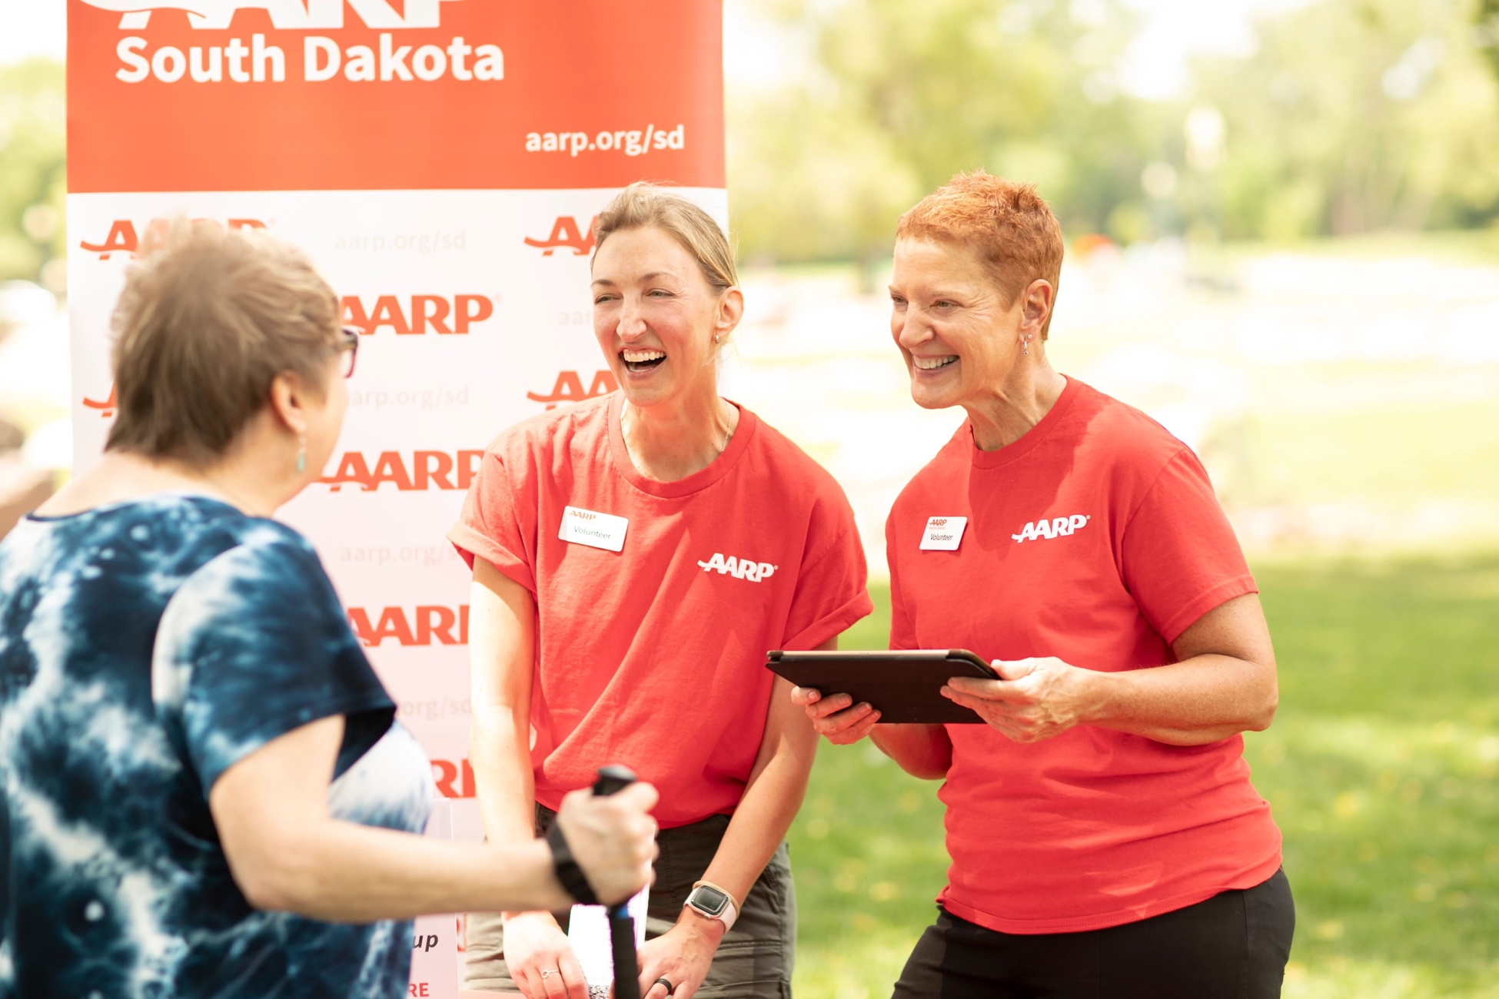
Giving back is a source of purpose for many.
Half are volunteering, either formally (i.e. with a non-profit organization, school, religious organization, club, or any other group) or informally (i.e. providing unpaid help that was not coordinated by an organization, such as cooking a meal or cleaning for someone).
Percent who volunteer
Among adults ages 50+, by age range
AARP
AARP
Giving Back: Attitudes and Behaviors Across the Lifespan. AARP Research, July 2019.
Notes:
Another element of purpose driven lives involves giving back, with about half of adults 50 and older giving back through volunteering. I want to underscore this tremendous contribution to society in strengthening our communities and bolstering civic engagement. For Black and African American volunteers 50 and older, volunteerism is community-focused, with 7 in 10 wanting to help their own neighborhood or community. Volunteerism also is often associated with church. For Hispanic adults 50 and older, volunteering largely happens informally, when they see a need – so they may be less inclined to consider the way they give back as volunteering – and more likely to see it as just doing the right thing.

Slide 34
“… A lot of people regret growing older… I don't. I just see it as part of a natural process…So I am at peace with my age group at this time… I love doing the things that I do…I love living in my house. I love being with my cats…that I live in a beautiful city in California, and I'm surrounded by a lot of culture and a lot of heritage here. -Man who self describes as having many interests, hobbies and passions, former photographer, in his 70s
Notes:
As we talk about engagement and purpose being integral to the story of adults age 50 and older, I want to discuss attitudes toward aging. I want to start with this quote from one of our research participants, “… A lot of people regret growing older… I don't. I just see it as part of a natural process…So I am at peace with my age group at this time… I love doing the things that I do…I love living in my house. I love being with my cats…that I live in a beautiful city in California, and I'm surrounded by a lot of culture and a lot of heritage here.
I think there is a lot packed into this quote. He talks about aging as a natural process, and the growing appreciation he has. But he also references society’s influence, and negative associations with aging, which we will talk about in a moment.

Slide 35
Adults age 50-plus highlight positive associations with aging.
Adults age 50-plus say they grow more comfortable being themselves, that they have a lot to look forward to, and they feel optimistic about the aging journey.
First two items: University of Michigan National Poll on Healthy Aging, “Everyday Ageism and Health” among adults ages 50-80 (July 2020); Last two items: AARP Research, “Healthy Living: A look at how older adults’ resiliency is related to healthy aging” (May 2022).
Notes:
First, I want to bring to the forefront that adults age 50 and older highlight positive associations with aging. As we can see in this chart, 9 in 10 adults age 50-plus feel more comfortable about being themselves as they age. Three quarters of adults 50-plus say they have a lot to look forward to and feel optimistic. We also frequently hear age meaning wisdom and clarity due to lived experience.

Slide 36
Yet, ageism is pervasive.
Ageism refers to the stereotypes (how we think), prejudice (how we feel) and discrimination (how we act) towards others or oneself based on age.
8 in 10
adults ages 50-80 regularly experience everyday ageism.
Ageism manifests in and is perpetuated by…
✓
Messages we see
✓
Interpersonal interactions
7.5 years
Difference in median survival for those with the most positive beliefs about aging vs. those with the most negative beliefs
✓
Institutions
✓
Our own minds (internalized ageist beliefs)
World Health Organization. 2021. “Ageing: Ageism.”; University of Michigan National Poll on Healthy Aging, “Everyday Ageism and Health,” (July 2020); “Exploring the Health Effects of Ageism.” The New York Times, 2022.
Notes:
Yet, ageism is pervasive. Ageism refers to discrimination, prejudice, and stereotyping based on age. 8 out of 10 adults ages 50-80 report regularly experiencing at least one form of everyday ageism. Even though everyone can experience ageism –both younger and older adults --society is not at the point where we recognize the problem.
Dr Tracey Gendron, in her book Ageism Unmasked talks about the various types of ageism, like exposure to ageist messages - we’re talking about birthday cards that solely make fun of older adults, the new trend where elementary school students dress up as 100-year olds in jest, to an entire anti-aging industry that profits off the idea that we should all be striving to look younger, to the phrase BoomerRemover trending on social media during the pandemic.
There is also interpersonal ageism, such as hearing the phrase, you “look good for your age” to assuming people don’t have skills and neglecting to value their contributions.
These beliefs matter not only because they are unkind, but they manifest in our institutions like the workplace. In fact, almost half of workers age 50-plus say they have experienced ageism in the workplace since turning 40 and this is especially felt among people who have historically experienced other types of workplace discrimination, including Black/African American, Hispanic and LGBTQ+ workers. In healthcare, it could mean treatable conditions are dismissed as a feature of old age, and more. I saw a story in the NYT of how in a few medical schools, older adults were brought in to share experiences with medical students to try to combat ageism. One woman was telling her story of how she was explaining to the doctor her symptoms, and he told her not to worry because fatigue is a normal part of getting older. Luckily she advocated for herself and went somewhere else because it turned out she had a serious infection.
And not only does it manifest in our institutions, it manifests in our own minds. We talked earlier about how older adults highlight positive views about aging. At the same time, we are not immune to societal influences. Internalized ageism includes “self-stereotyping and negative attitudes towards one's own aging.” Dr. Becca Levy has demonstrated that ageism is associated with physical and cognitive health, and found that the median survival was seven and a half years longer for those with the most positive beliefs about aging, compared with those having the most negative attitudes.

Slide 37
As disability rates rise with age, the potential for intersectional discrimination increases.
Ableism is a set of beliefs or practices that devalue and discriminate against people with physical, intellectual, or psychiatric disabilities.
“As a woman over 55+, I noticed it diminished my ability to find jobs as a free lancer or contractor. Aging discrimination is more prevalent especially if you have a disability such as Deaf. It’s like having a triple standard and it’s not obvious but it’s hidden.”
-woman who does freelance work
Smith, Leah. 2023. “#Ableism – Center for Disability Rights.”; AARP Research analysis of 2022 American Community Survey (ACS PUMS).
Notes:
It is also important to be aware of these issues in the context of ableism. Ableism is a set of beliefs or practices that devalue and discriminate against people with disabilities, and as we see with the blue line on this chart, as age increases across the horizontal axis, disability rates rise from 12% at age 50 to 26% at age 70 to 79% over 90. As such, the potential for intersectional discrimination involving ageism and ableism increases. As one of our research participants reflects, “As a woman over 55+, I noticed it diminished my ability to find jobs as a free lancer or contractor. Aging discrimination is more prevalent especially if you have a disability such as Deaf. Its like having a triple standard and its not obvious but its hidden.” So, society suffers with ageism and ableism because it stands in the way of allowing people to give all they have to offer.
*****************************************************************
Hearing: deaf or have serious difficulty hearing
Vision: blind or have serious difficulty seeing even when wearing glasses
Cognitive: serious difficulty concentrating, remembering or making decisions due to a physical, mental or emotional condition
Ambulatory: serious difficulty walking or climbing stairs
Self-care: difficulty dressing or bathing
Independent living: difficulty doing errands alone such as visiting a doctor’s office or shopping due to a physical, mental or emotional condition

Slide 38
To resonate, educate and engage, reframe aging as a continual progression, an accumulation of LIVED EXPERIENCE.
Today we learned… |  | How to resonate, educate or engage…
Connections are increasingly seen as a source of joy, purpose. |  | Focus on what adults age 50 and older value most– relationships.
Life lessons help build resilience. |  | Discuss aging as growth.
While challenges in health increasingly occur, they do not define adults age 50 and older. |  | Acknowledge and build for challenges with aging.
Disparities in health and wealth lead to accumulated stressors and inequitable outcomes. |  | Embed equity in discussions on aging.
Contributions to society are numerous—working, giving back, caregiving, parenting, grandparenting, etc. Purpose is a mainstay. |  | Recognize societal contributions and the value of their lived experience.
Attitudes about age and aging impact well-being. |  | Re-frame aging as a multidimensional journey—that all people are on.
Is Your Brand Missing Out on the 50+ Market?, AARP
Notes:
So, I am going to sum up what we learned today and talk about what that could mean for resonating with adults age 50 and older or educating about the aging experience.
We learned: Connections are increasingly seen as a source of joy and purpose. So, resonating includes focusing programming on growing existing or building new relationships.
We learned: Lessons in life help build resilience and prioritize what is important. So, we have an opportunity to discuss aging as growth.
We learned: Challenges in physical health increasingly occur, but do not define adults age 50 and older. So, we should not shy away from this. We need to acknowledge and build for these challenges but also recognize aging is complex and also includes opportunities.
We learned: Disparities in health and wealth lead to accumulated stressors and inequitable outcomes, meaning equity must be embedded in discussions on aging.
We learned: Contributions to society are numerous – working, giving back, caregiving, child care and more. To resonate, we must reflect societal contributions of adults age 50 and older, and value their lived experience.
We learned: Attitudes about aging impact personal and societal well-being. We have an incredible opportunity to educate and reframe aging as a multi-dimensional journey. As Dr Tracey Gendron says, aging starts from the day we are born. Too often at some arbitrary point we stop talking about aging as upward progression, and start only talking about it as decline, instead of an accumulation of LIVED EXPERIENCE.
thank you for your time today.

Slide 39
Sarah Kerman, AARP Research
This report was designed and executed by AARP Research.

